Slide 1
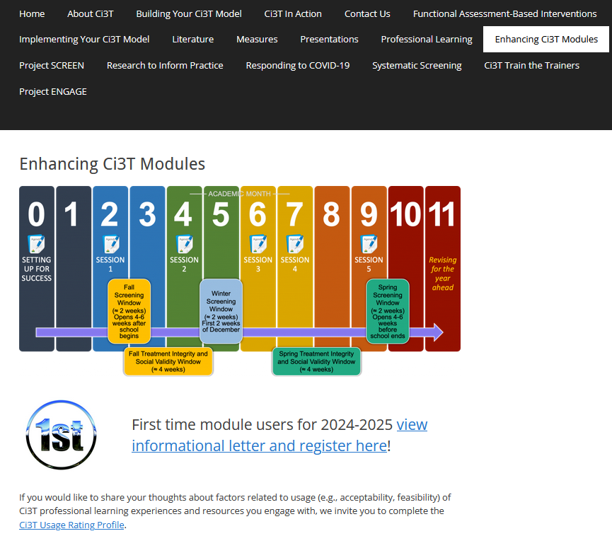
Tier 2: Behavior Contracts
Kathryn L. Johnson, Allison M. Bernard, &
Kathleen Lynne Lane, Ph. D., BCBA-D, CF-L2
University of Kansas
If you have not done so already, we invite you to visit ci3t.org/enhance to access modules after a one-time registration process!
This project was funded in part by Project EPIC
(USDE, OSEP Award Number: H325D220011)
and Project ENHANCE
(IES Project Number R324N190002)

Slide 2
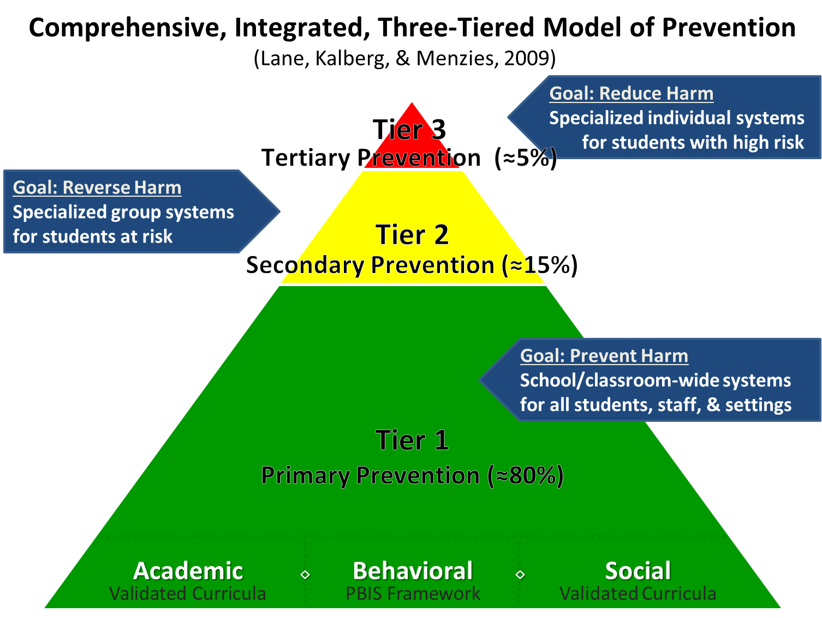
Comprehensive, Integrated, Three-Tiered Model of Prevention 1

Slide 3


Enhancing Ci3T Modules
ci3t.org/enhance

Slide 4
Session Outcomes
Describe how secondary (Tier 2) interventions are situated in a Ci3T model of prevention including the purpose and organization of Secondary (Tier 2) Intervention Grids.
Follow a step-by-step process to implement behavior contracts.
Explain the importance of and prepare to monitor treatment integrity, social validity, and student performance data.

Slide 5
Agenda
Welcome
Overview of Secondary (Tier 2) Interventions within a Ci3T Model of Prevention
Behavior Contracts as a Tier 2 Intervention
  Introduction to Behavior Contracts
  9-Step Process to Implement Behavior Contracts
Wrapping Up and Moving Forward

Slide 6

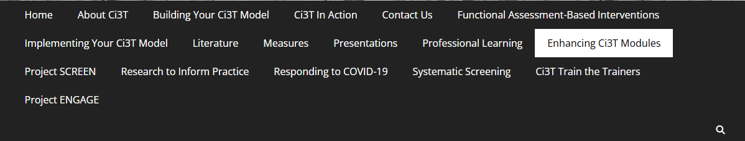
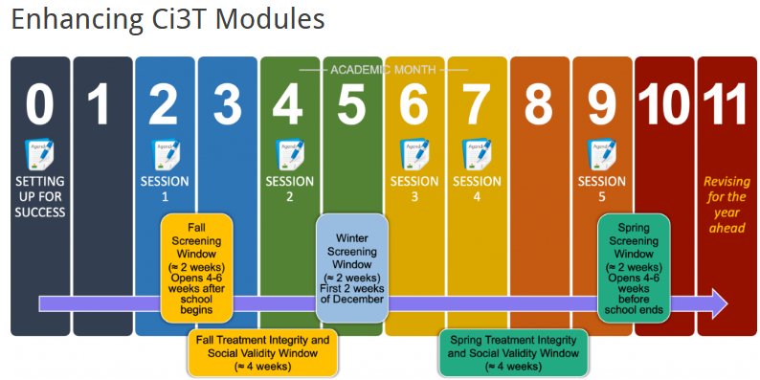
Accessing Professional Learning Materials
ci3t.org/enhance

Slide 7
Overview of Secondary
(Tier 2) Interventions in Ci3T Models

Slide 8
Comprehensive, Integrated, Three-Tiered Model of Prevention 2

Slide 9

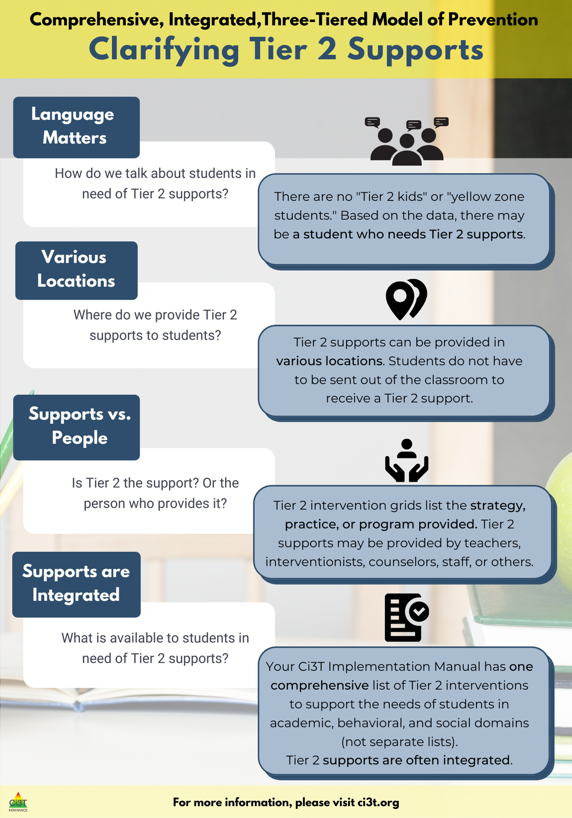
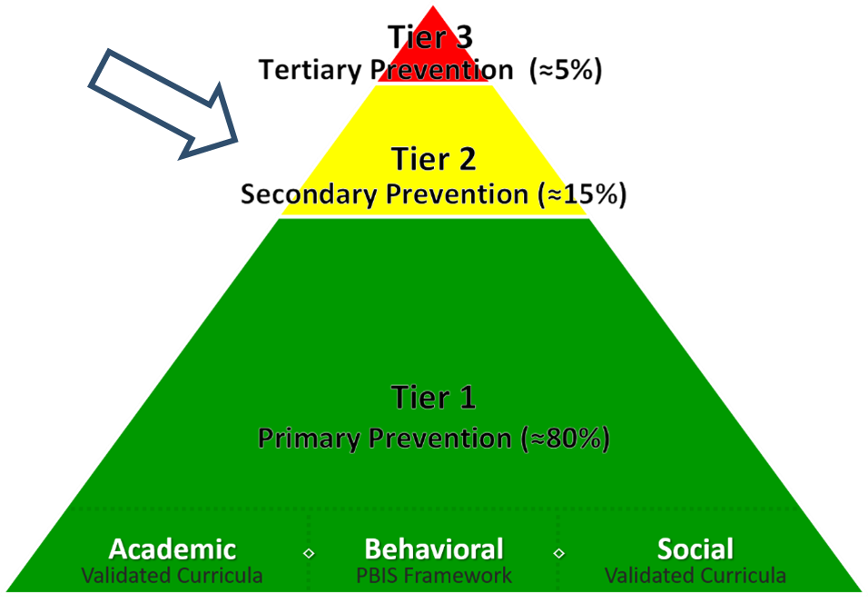
What are Tier 2 Interventions?

Slide 10

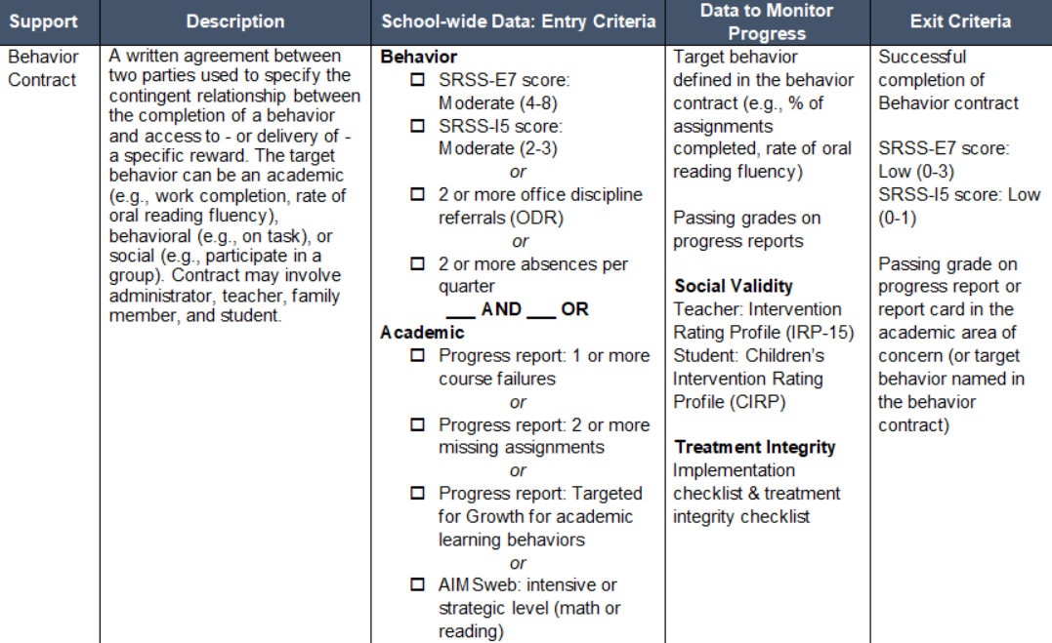
Components of Secondary (Tier 2) Intervention Grid
Notes:
Support- name of strategy, practice, or program. Notice this is not the name of a person or role

Slide 11

Behavior Contracts as a Tier 2 Intervention
Behavior Contracts as a Tier 2 Intervention: Overview of Behavior Contracts
Overview of Behavior Contracts
9-Step Process to Implement Behavior Contracts

Slide 12

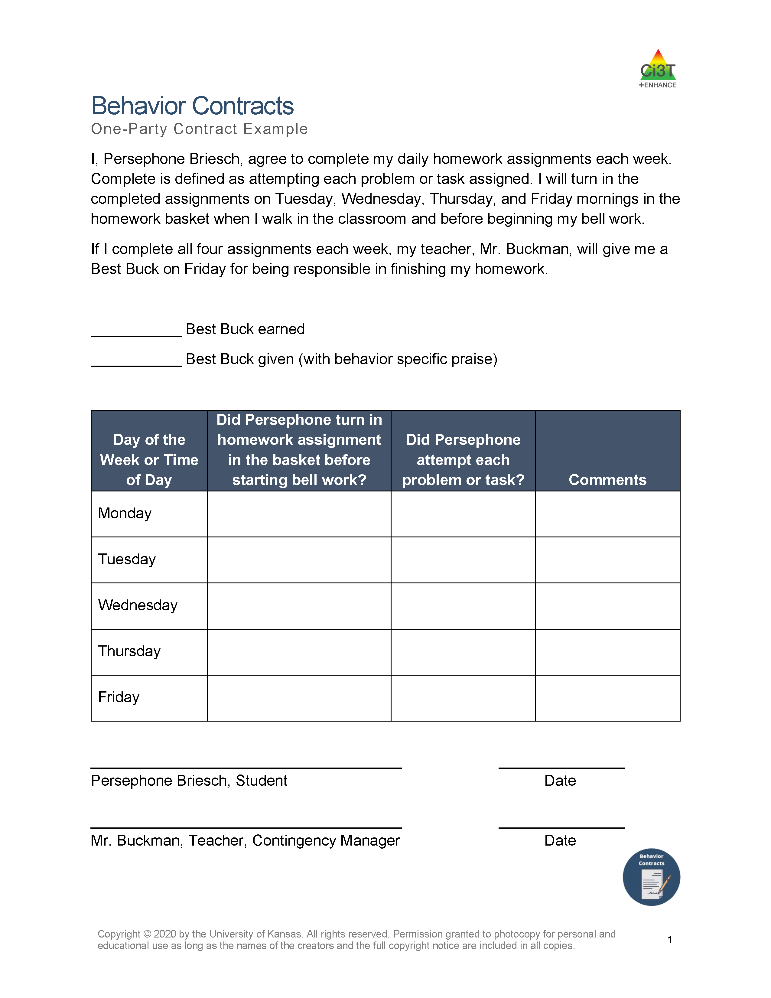
What is a Behavior Contract?
A behavior contract is a mutually agreed-upon document between at least two individuals in which one or both individuals agree to demonstrate a certain behavior or behaviors.
Behavior contracts have three components:
Behavior
Reward
Recording Sheet
Notes:
Behavior contracts specify a contingent relation between the completion of a specified behavior and access to or the delivery of a specific reward.

Slide 13
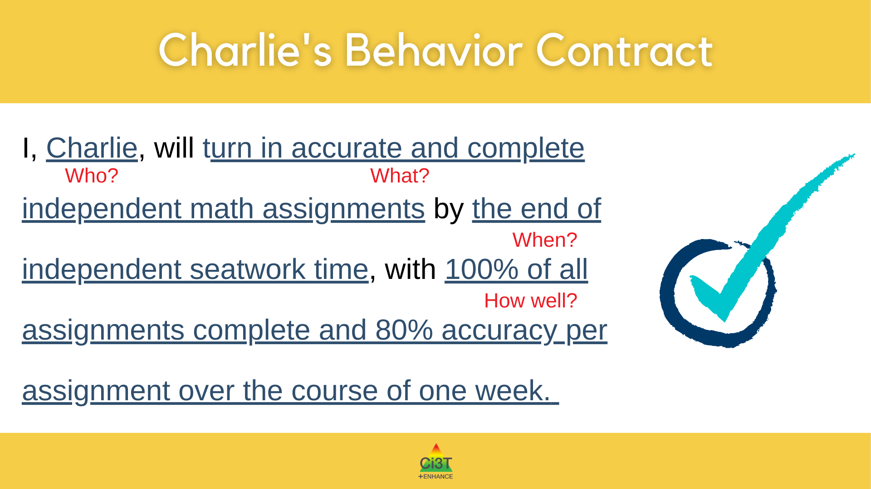
Component 1: Behavior
Behavior: The behavior includes four pieces of information.
Who: the people entering into the contract
What: the behavior (or behaviors) to be performed
When: the time when the behavior will occur
How Well: level of performance of the behavior
Notes:
When specifying the behavior or task, it is important to include four pieces of information: who, what, when, and how well.
WHO refers to the parties entering into the contract and can include students, teachers, family members, paraprofessionals, or other staff members.
WHAT refers to the behavior to be performed, which is precisely defined in the contract.
WHEN identifies the time by which the behavior must be completed.
HOW WELL specifies the levels of performance or standards to meet criterion.

Slide 14
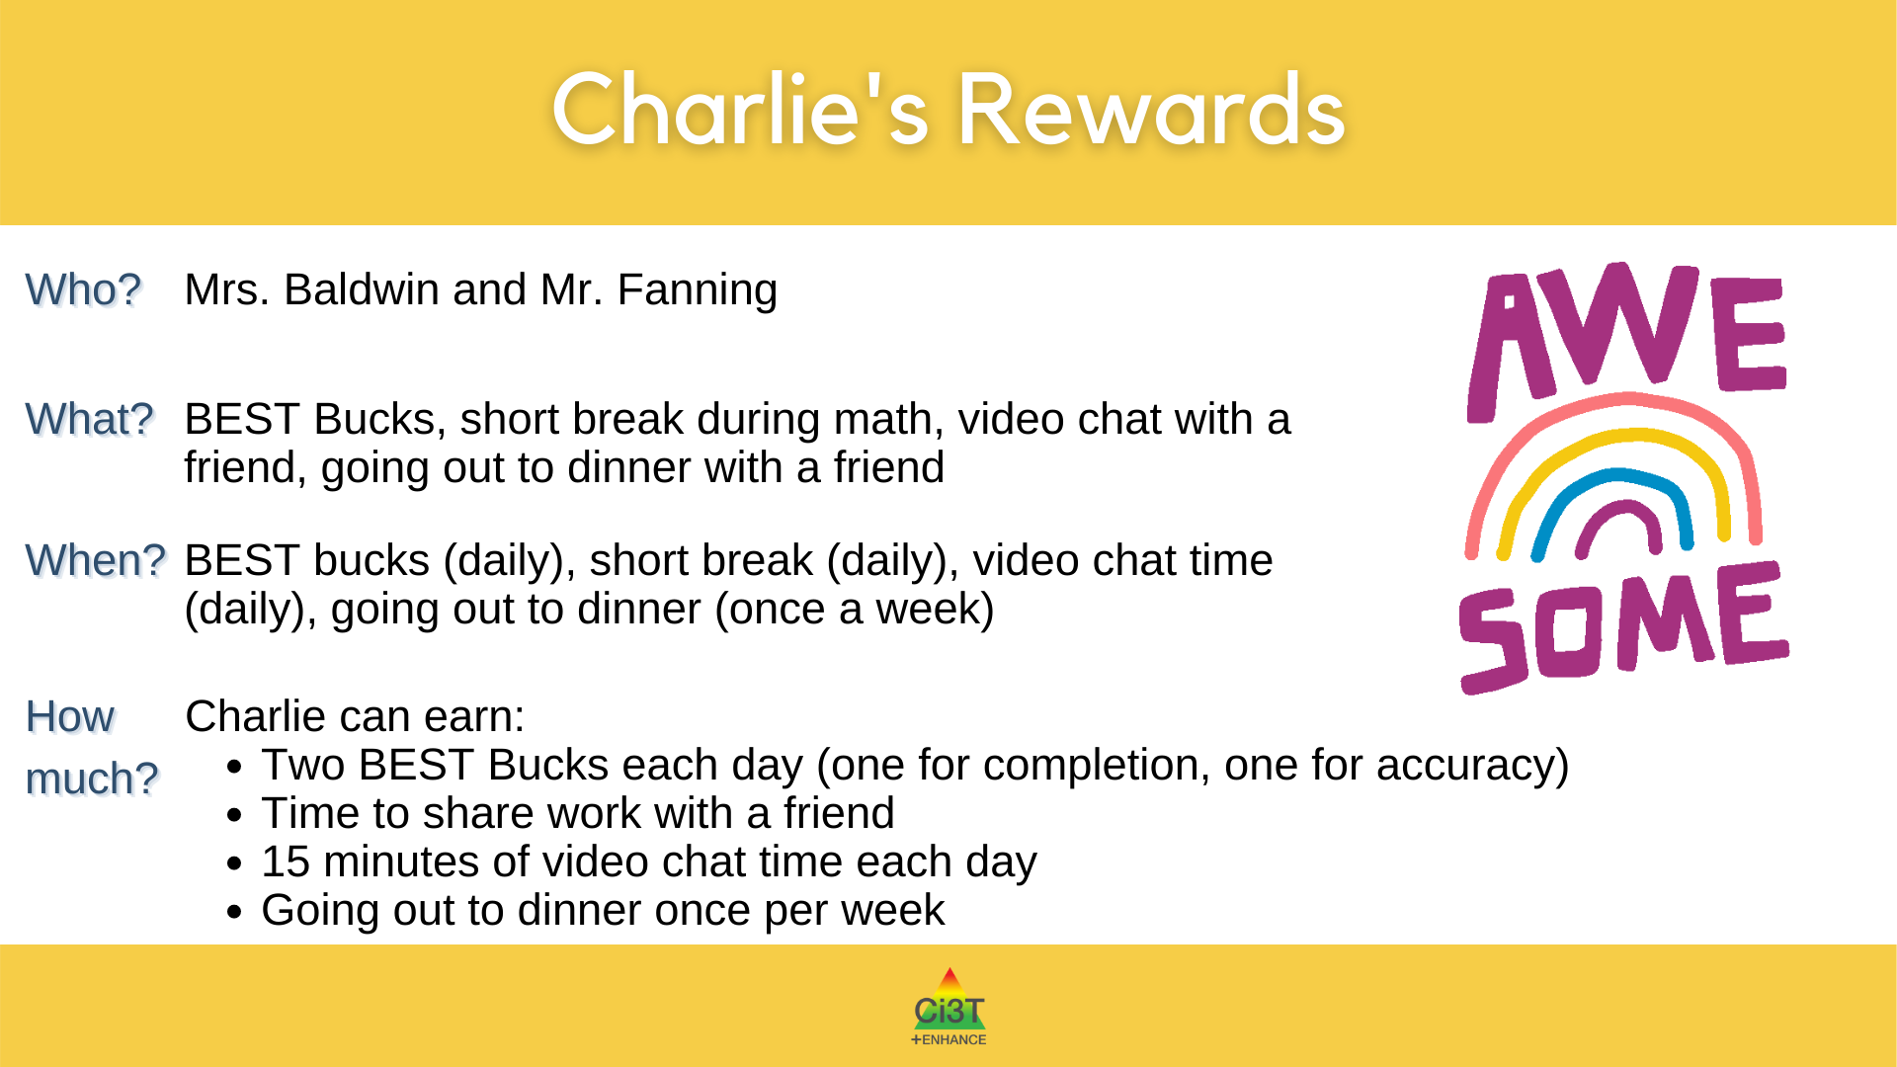
Component 2: Reward
Reward: The reward also includes four pieces of information.
Who will give the reward
What the reward will be
When will the reward be given
How much will the reward be

Slide 15
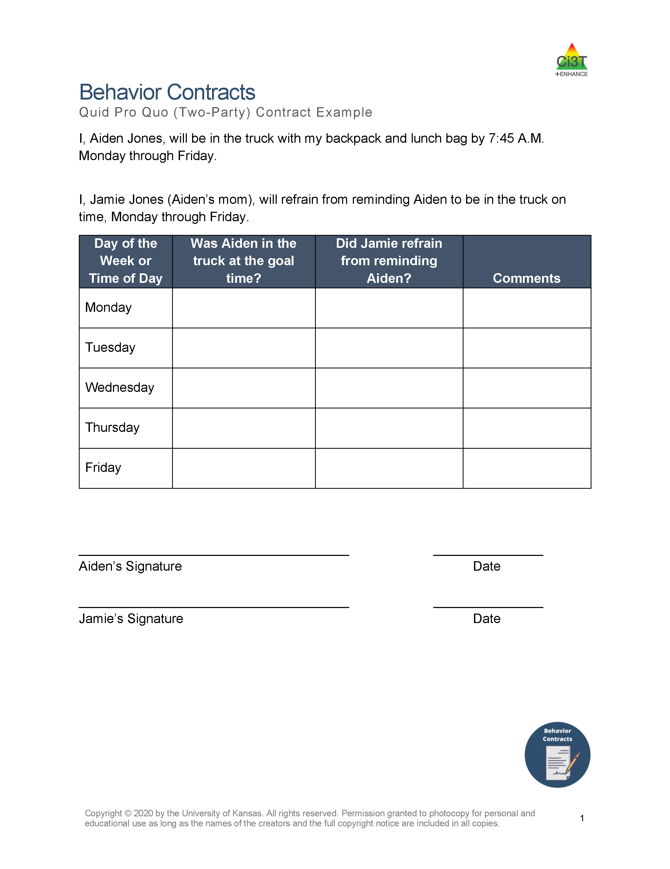
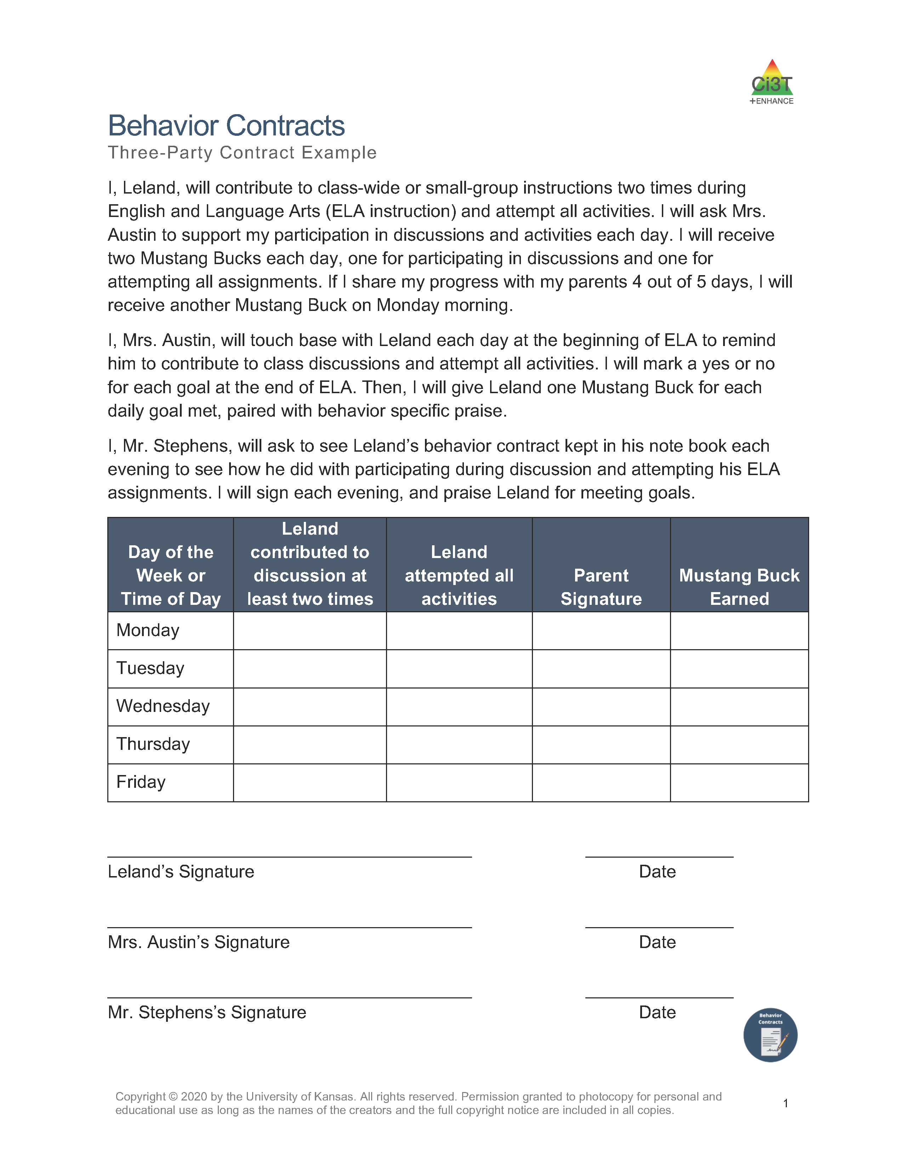
Component 3: Recording Sheet
Recording Sheet: A document designed to serve as a prompt for all parties to review the contract regularly and to provide a method for recording behavior performance.
Notes:
It is important that this document is understandable to all parties involved, including students, teachers, and family members. It is also important to regularly measure and review progression towards the goal to ensure the contract is effective.

Slide 16
Recording Sheet

Slide 17
Why are Behavior Contracts Effective?
Behavior Contracts are based on several behavioral principles:
  Rule governed behavior
  Public commitment
  Positive reinforcement
  Negative reinforcement
Behavior contracts involves an antecedent adjustment (a shift in the environment in which a challenging or undesirable behavior occurs) that sets the stage for increasing the likelihood that a new, more adaptive or desirable behavior will occur
(Cooper et al., 2020; Miltenberger et al., 2004)
Cooper, J. O., Heron, T. E., & Heward, W. L. (2020). Applied behavior analysis (3rd ed.). Merrill/Prentice Hall.
Miltenberger, R. G., Flessner, C., Gatheridge, B., Johnson, B., Satterlund, M., & Egemo, K. (2004). Evaluation of behavioral skills training to prevent gun play in children. Journal of Applied Behavior Analysis, 37(4), 513-516. https://doi.org/10.1901/jaba.2004.37-513
Notes:
A behavior contract explains a rule which clearly sets a plan for how an individual can access something desirable by doing something less desirable.
Behavior contracts specify how a person can access reinforcement upon performing a specific, publicly declared behavior.
In other words, a behavior contract is an antecedent-based intervention which adjusts the environment to facilitate a specific behavior.

Slide 18
Behavior contracts can be used to…
Increase desired behaviors:
  Appropriate social interactions
  Attendance
  Grades
  On-task / academic engagement
  Work completion
Decrease undesired behaviors:
  Aggression
  Disruptive behavior
  Truancy
  Rule violations

Slide 19
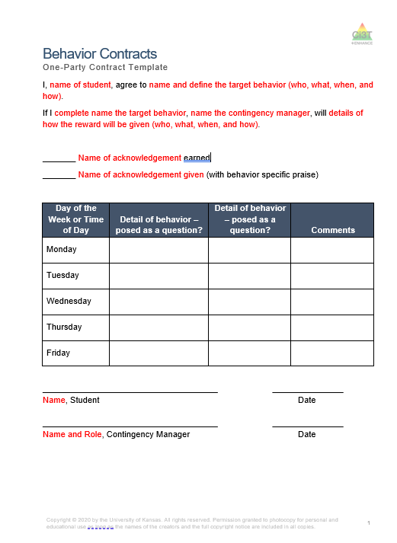
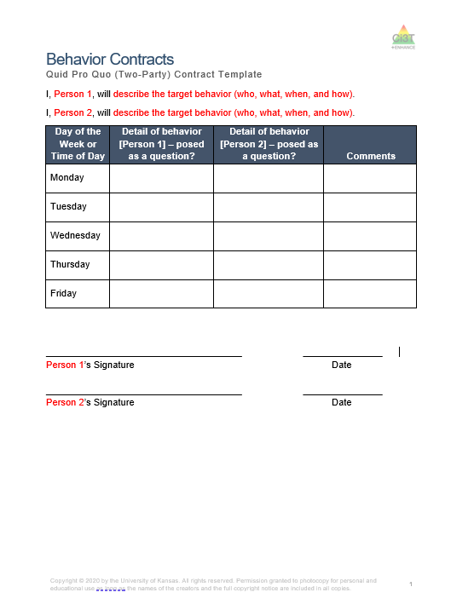
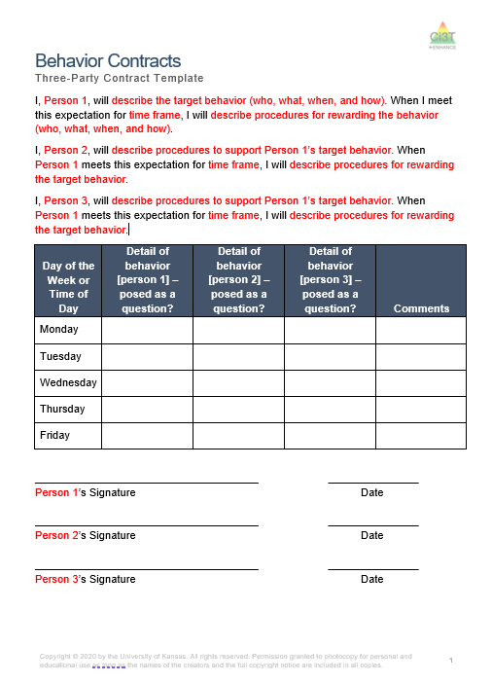
Types of Behavior Contracts
See Behavior Contracts Module for examples and templates (available in English and Spanish!)

Slide 20
One-Party Behavior Contract
Notes:
One person changes their own behavior.
Contingency manager ensures fidelity to the contract and deliverance of the reward.

Slide 21
Quid Pro Quo (Two-Party) Behavior Contract
Notes:
QUID PRO QUO: behaviors are linked. One person’s behavior change serves as a reinforcer for another person’s behavior change. For example, if you agree to make dinner, then I will agree to clean the dishes.

Slide 22
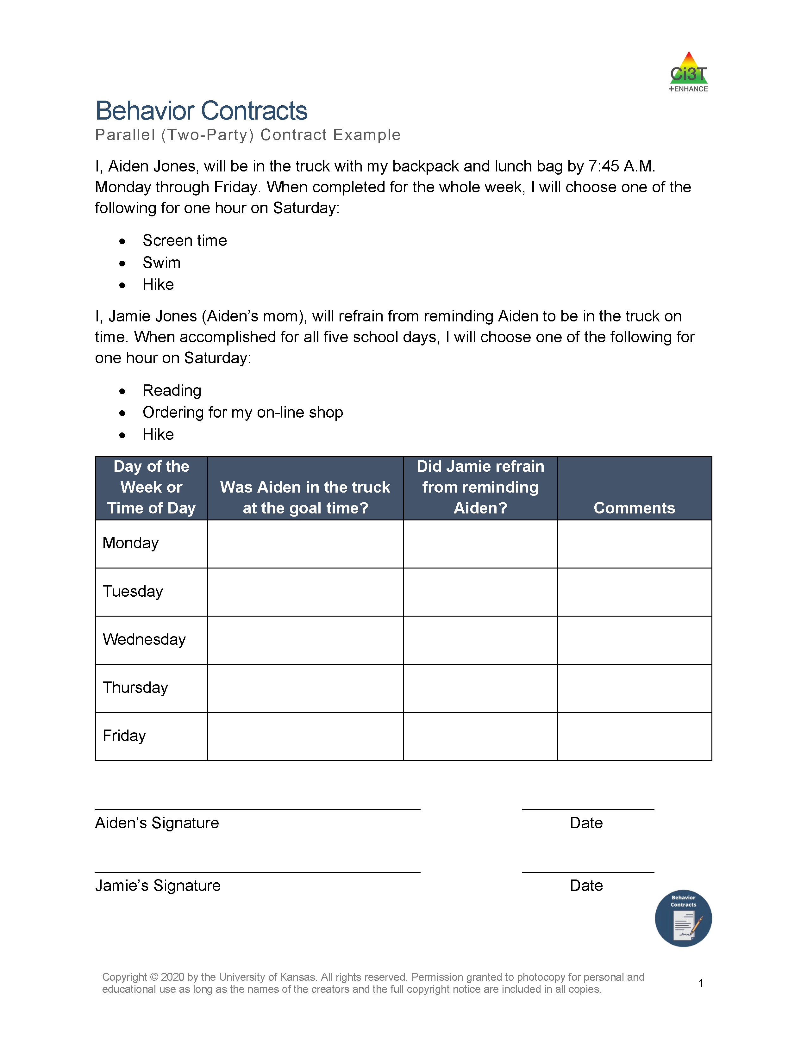
Parallel (Two-Party) Behavior Contract
Notes:
PARALLEL: behaviors are not linked. Involves each person changing a behavior that is important to the other person, but the rewards are not contingent upon, or linked to, the other person’s behavior. For example, if you agree to work on your math homework, I will agree to work on my science homework.

Slide 23
Three-Party Behavior Contract
Notes:
One person sets a goal.
Two or more others support by providing reinforcement and feedback to the first person.

Slide 24

Talk Time
Talk Time 1
What are your initial thoughts and reactions?
What components of behavior contracts seem most feasible?
What questions do you have about the different types of contracts?
What might be challenging about implementing behavior contracts?
Notes:
5-min

Slide 25
Behavior Contracts as a Tier 2 Intervention
Behavior Contracts as a Tier 2 Intervention: 9-Step Process to Implement Behavior Contracts
Overview of Behavior Contracts
9-Step Process to Implement Behavior Contracts

Slide 26
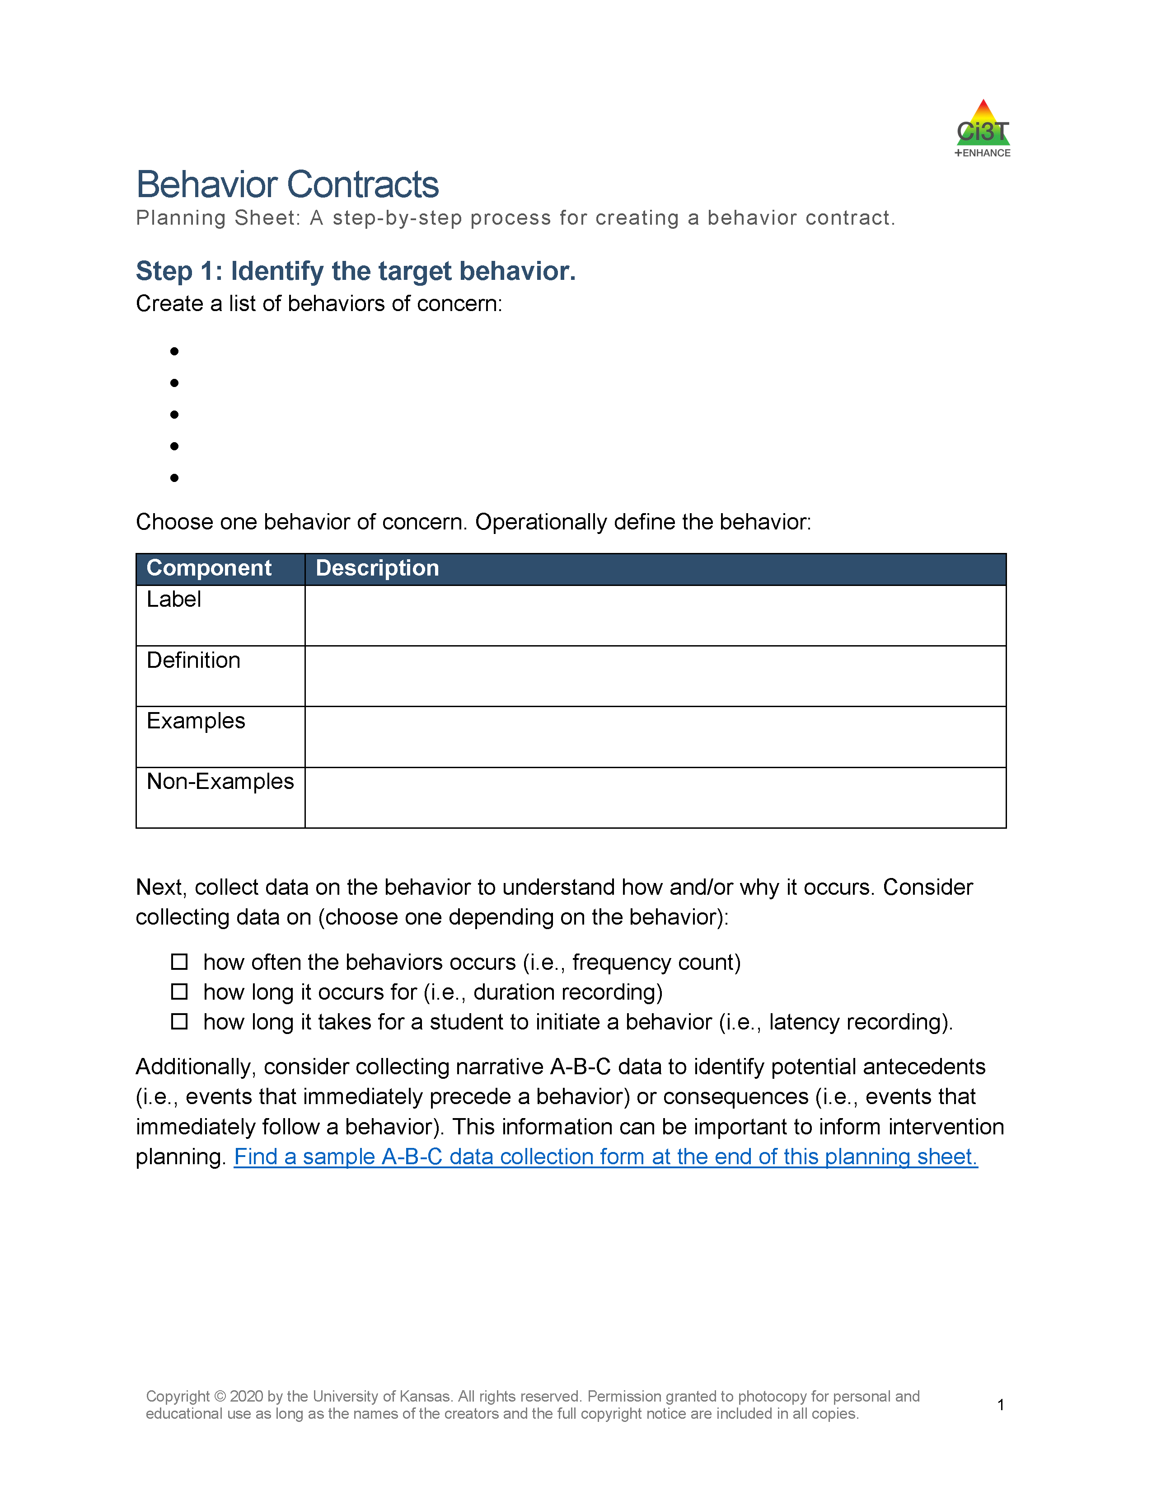
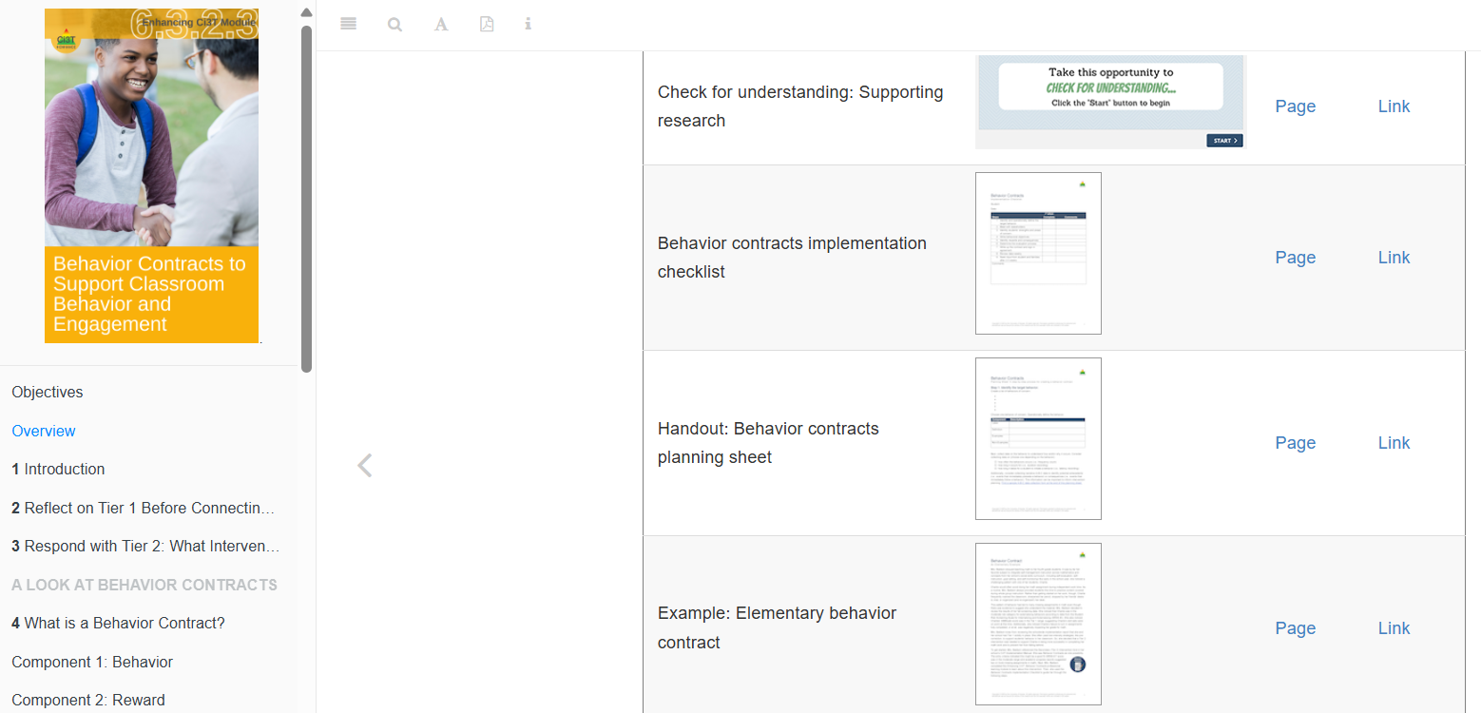
A 9-Step Process to Implement Behavior Contracts
Notes:
Model:
Log into module: https://kusurvey.ca1.qualtrics.com/jfe/form/SV_6mvf1kc4F7Uz3Ku
Navigate to Table of Resources
Download planning guide

Slide 27
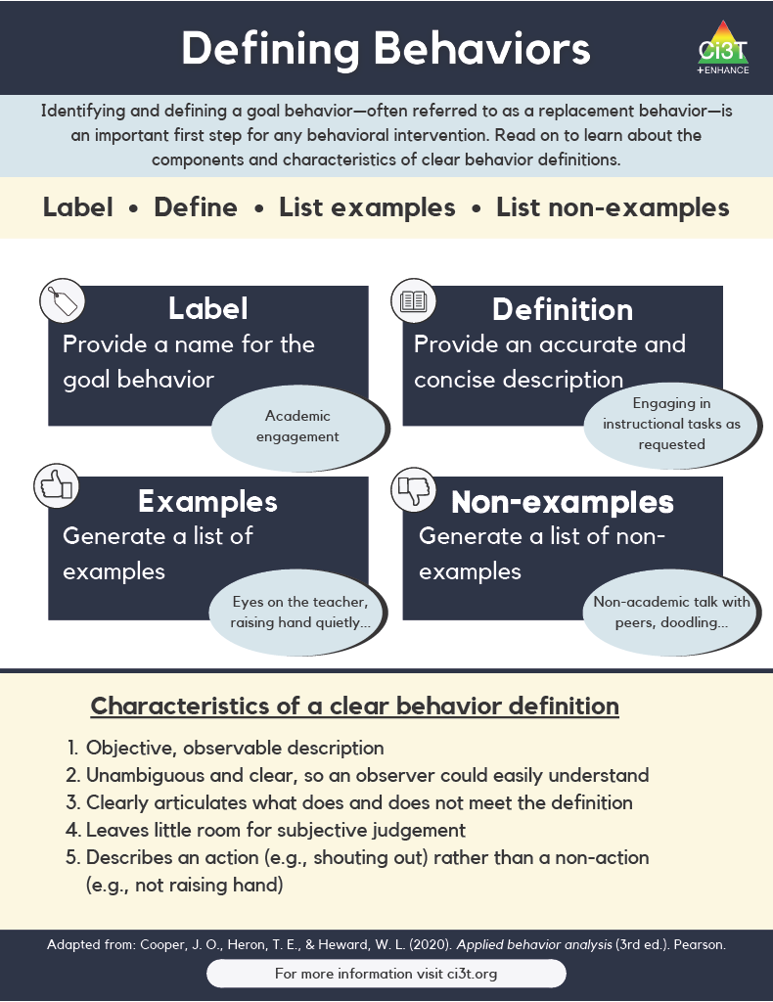
Step 1: Identify contexts and anticipated behaviors
Operationally define challenging behavior(s) you are looking to reduce
Identify in which contexts those challenging behaviors are most likely to occur
  Time of day?
  Type of activity?
  Location?
Notes:
The first step is to operationally define the target behaviors so that everyone has a shared understanding of what the challenging behavior looks like. This should include a label, definition, examples, and non-examples.
When considering contexts in which challenging behaviors are most likely to occur, you may think about such factors such as:
Time of day (e.g., Are students more likely to call out in the morning? Later in the day?)
Type of activity (e.g., Are students more likely to engage in off-task behavior during small-group activities than during large-group instruction?)
Location (e.g., Are students more likely to engage in aggressive behavior on the playground or during lunchtime?

Slide 28
Example Operational Definition
Component | Description
Label | Participation
Definition | Participation behavior is defined as responding to teacher - or peer-initiated interactions
Examples | Raising hand, verbally responding to teacher-led questions, volunteering information during academic task, verbally responding during choral response, using non-verbal responses when prompted (e.g., thumbs up/down, response cards)
Non-Examples | Keeping hands down, making no verbal utterances during an academic task

Slide 29
Step 2: Meet with stakeholders
Schedule a meeting with all parties (e.g., teacher, student, family members or other educators involved in the student's success)
  Goal 1: Ensure everyone understands the need, details, and anticipated outcomes of the intervention
  Goal 2: Promote buy-in by incorporating input from all parties, ensuring shared goals and comfort with the plan
Explain the intervention details
Encourage participation and feedback
  Ensure all parties have a voice in developing the intervention, agree on data collection, feedback mechanisms, and reinforcement strategies
  Ensure all adults working with the student understand and can support the behavior contract
Notes:
First: Arrange a meeting with the teacher, student, and potentially family members or other educators involved in the student's success.
Then, during the meeting: Explain the intervention details to ensure that everyone understands why the contract is needed.
Use tools like the behavior contract Tier 2 intervention grid to illustrate the intervention's support structure, decision-making process, and monitoring criteria.
Throughout the meeting: Encourage Participation and Feedback
Involve families and students in discussing the goals, procedures, and outcomes to enhance social validity.
Ensure all parties have a voice in developing the intervention, agree on data collection, feedback mechanisms, and reinforcement strategies.
Ensure all adults working with the student understand and can support the behavior contract.

Slide 30
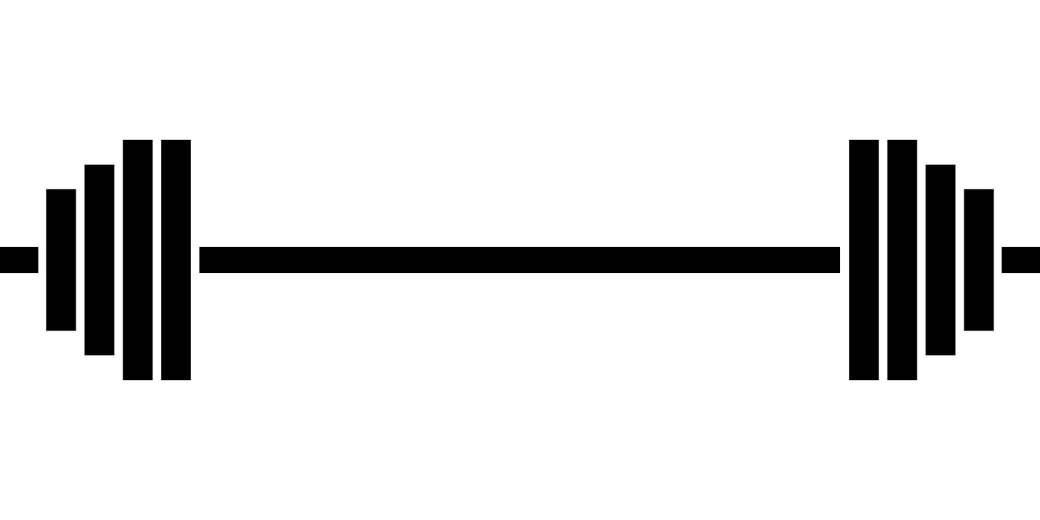
Step 3: Identify student’s strengths and areas of concern
Highlight student strengths
  Begin the meeting by discussing the student's positive attributes and accomplishments (e.g., excellent reading skills, regular attendance)
Introduce target behavior
  Share the behavior to be shaped, explaining its significance and the benefits of improvement (e.g., increased engagement leads to better learning and social interactions)
Invite parent and student input
  Encourage parents and students to share their perspectives on academic, behavioral, and social successes

Slide 31
Talk Time
Talk Time 2
How would you prepare to facilitate a conversation with students and families about…
    Student strengths
    Target behaviors
Notes:
5-min

Slide 32

Step 4: Write behavioral objectives
Components of a Comprehensive Behavioral Objective:
  Target individual (i.e., Who will perform the task?)
  Goal (desired) behavior (i.e., What will the student do?)
  Conditions of performance (i.e., Under what circumstances?)
  Criterion for success (i.e., How well?)
    Consider baseline data to set ambitious yet achievable goal
  Time frame for completion (i.e., By when?)
  Data collection method (i.e., Assessed how?)
Notes:
The next step is to create a behavioral objective. This will clarify what the student is expected to do to receive a reward.
It should specify:
WHO is expected to perform the target behavior
WHAT the desired behavior is that the student is expected to perform
CONDITIONS of performance
CRITERION for success (which should be realistic for the student to achieve and can be set using baseline data)
TIMEFRAME for completion
METHOD of data collection

Slide 33
Example Behavioral Objective
Behavioral Objective Planning
Who | Manny
Goal (Desired) Behavior | will raise his hand and wait to be called on before responding
Conditions of Performance | during circle time
Criteria for Success | 50% of the time
Timeframe | by the end of the school week
Data Collection Method | Teacher records the number of hand raises and call outs on a behavior log
Behavioral objective statement:
During circle time, Manny will raise his hand and wait to be called on before responding an average of 50% of the time throughout the school week as determined by his teacher, who will record the number of hand raises and call outs on a behavior log
Long-term goal
Manny will meet the objective of his behavior contract in 7 out of 8 weeks

Slide 34
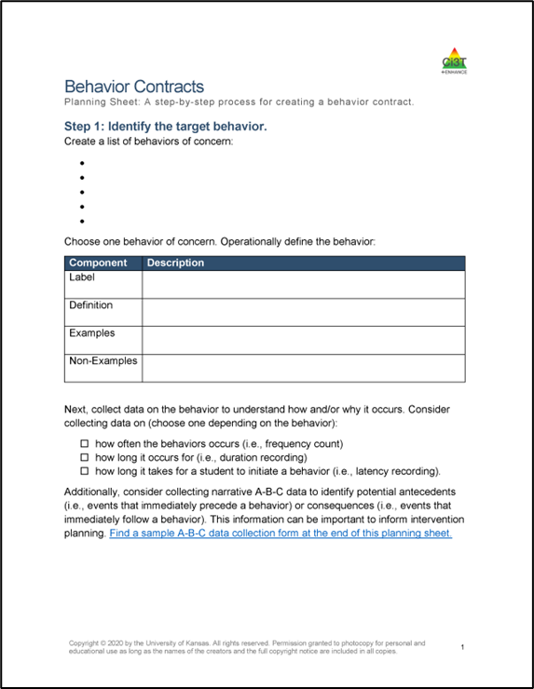
Talk Time
Talk Time 3
Think of the students in your own class, which target behaviors would you select?
Notes:
5-min

Slide 35
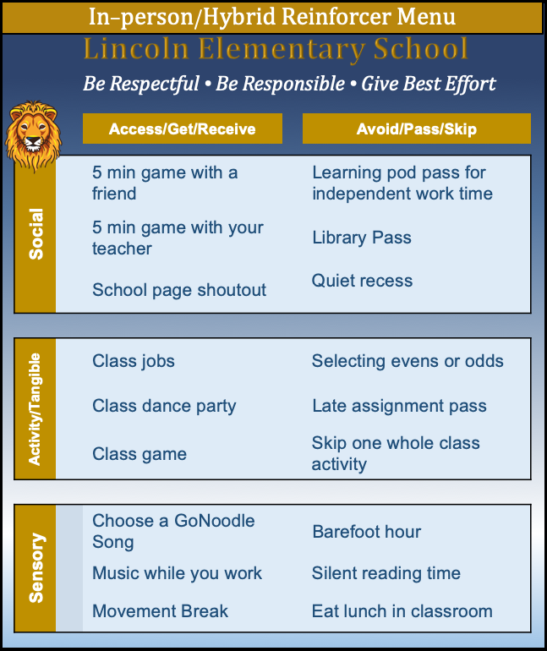
Step 5: Identify rewards and consequences
Start with the school-wide universal reinforcement system (e.g., tickets)
Identify effective reinforcers
Consider including a bonus clause
  Offer additional rewards for exceeding performance criteria (e.g., selecting two items for 80% or more hand raises)
Coordinate with family for home-based rewards
  Brainstorm feasible and desirable rewards (e.g., special meals, extra friend time, avoiding chores), ensuring they are provided if goals are met

Slide 36
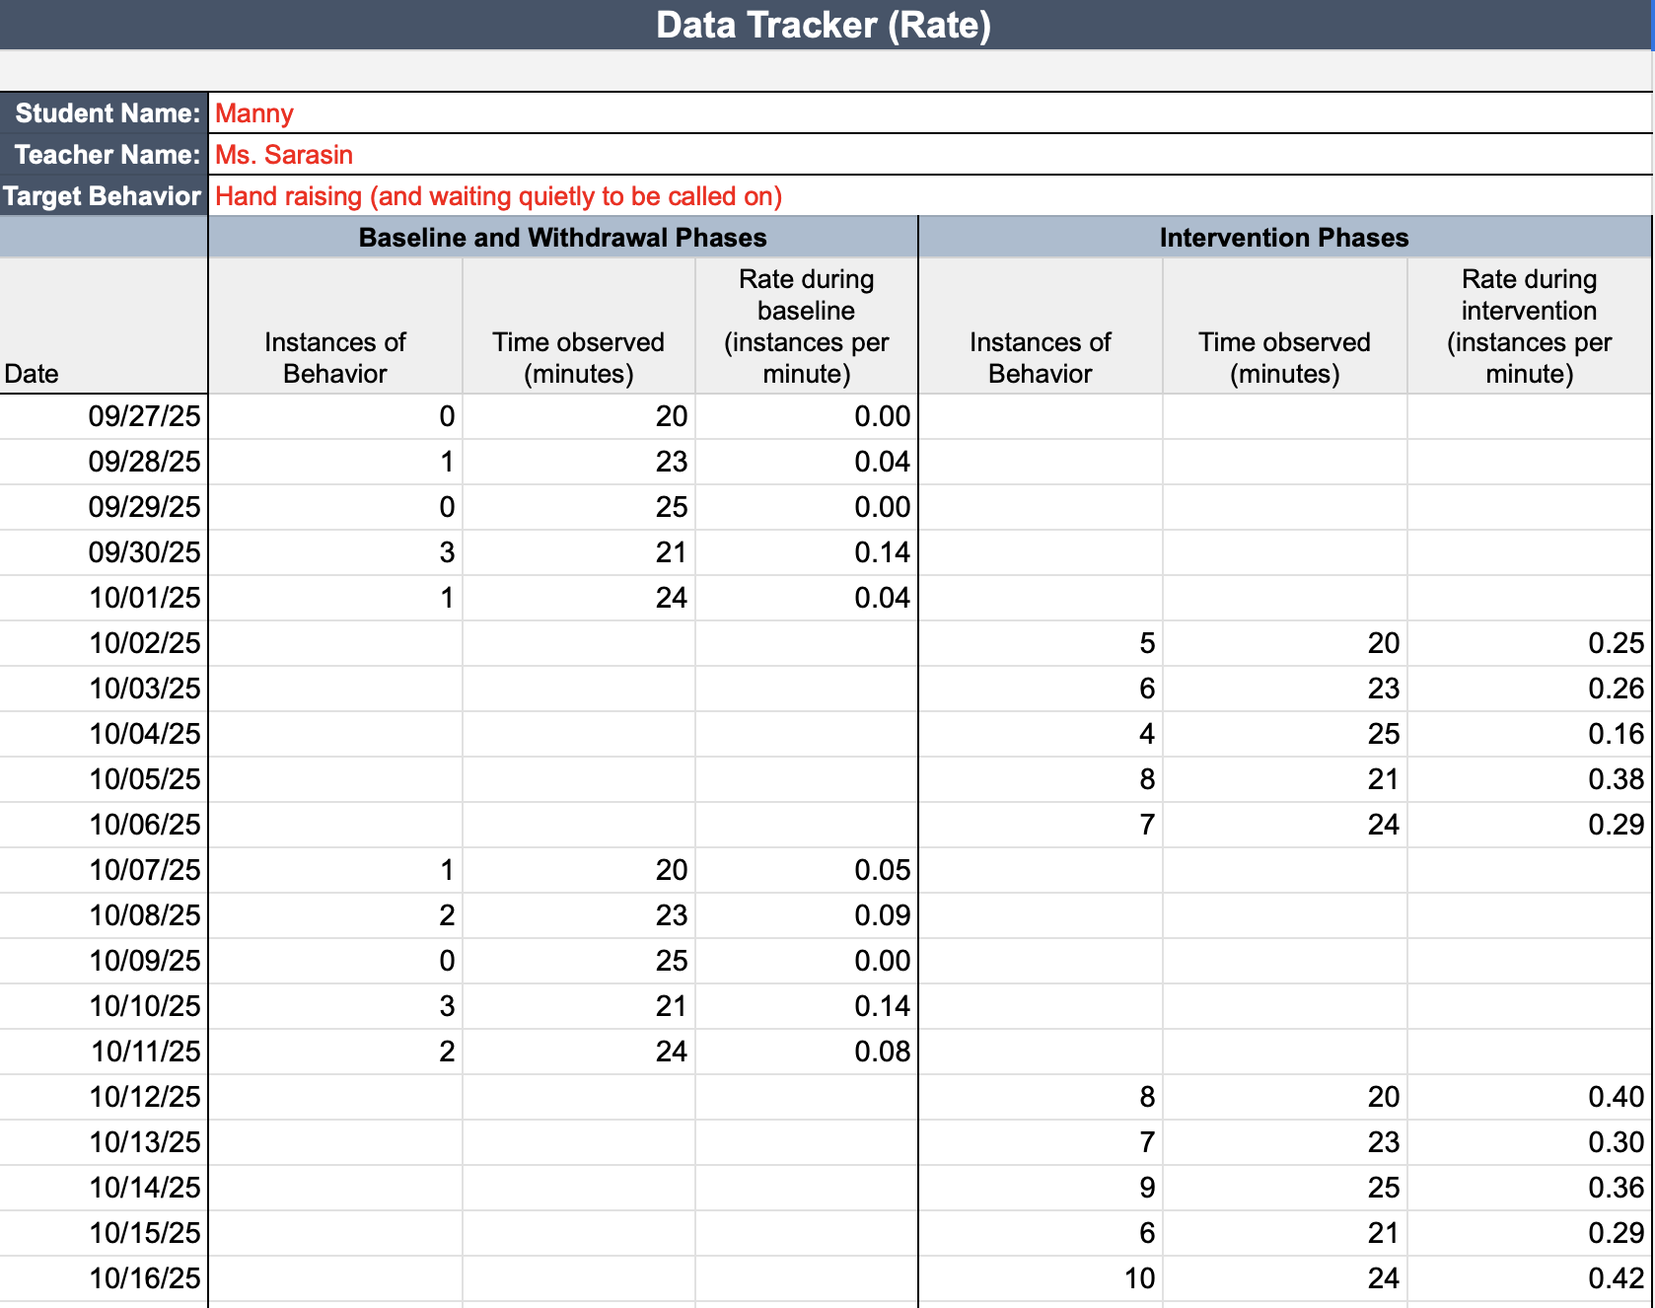
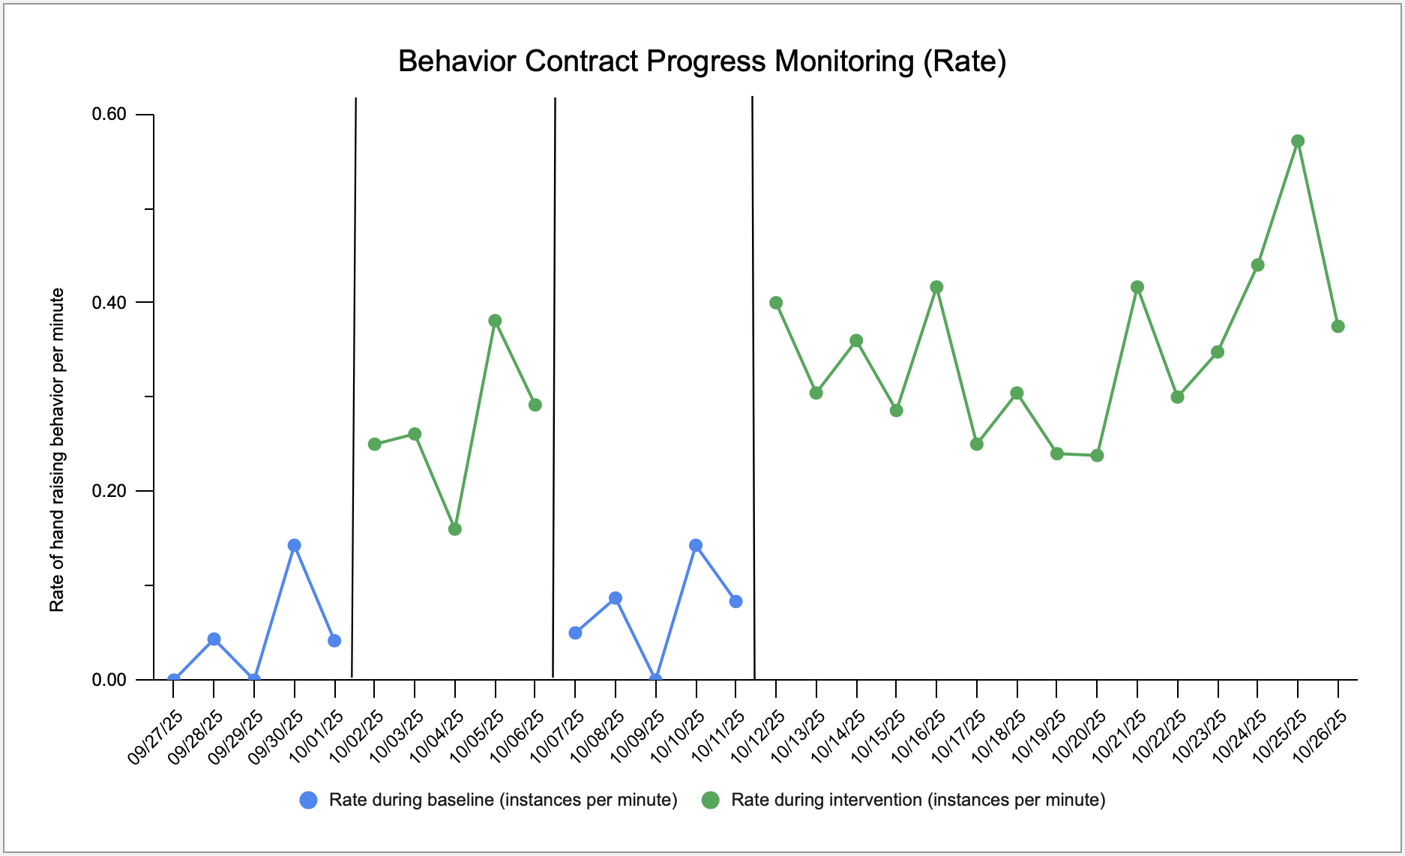
Step 6: Determine evaluation process
Determine data collection method (e.g., data collection sheet, digital tracker)
Establish a timeline for the contract with regular checkpoints to discuss whether to adjust or discontinue the contract

Slide 37
Step 7: Write up contract and sign in agreement
Draft the contract
Consider simplifying language and use of visuals
All parties sign the contract to indicate their agreement with the plan

Slide 38
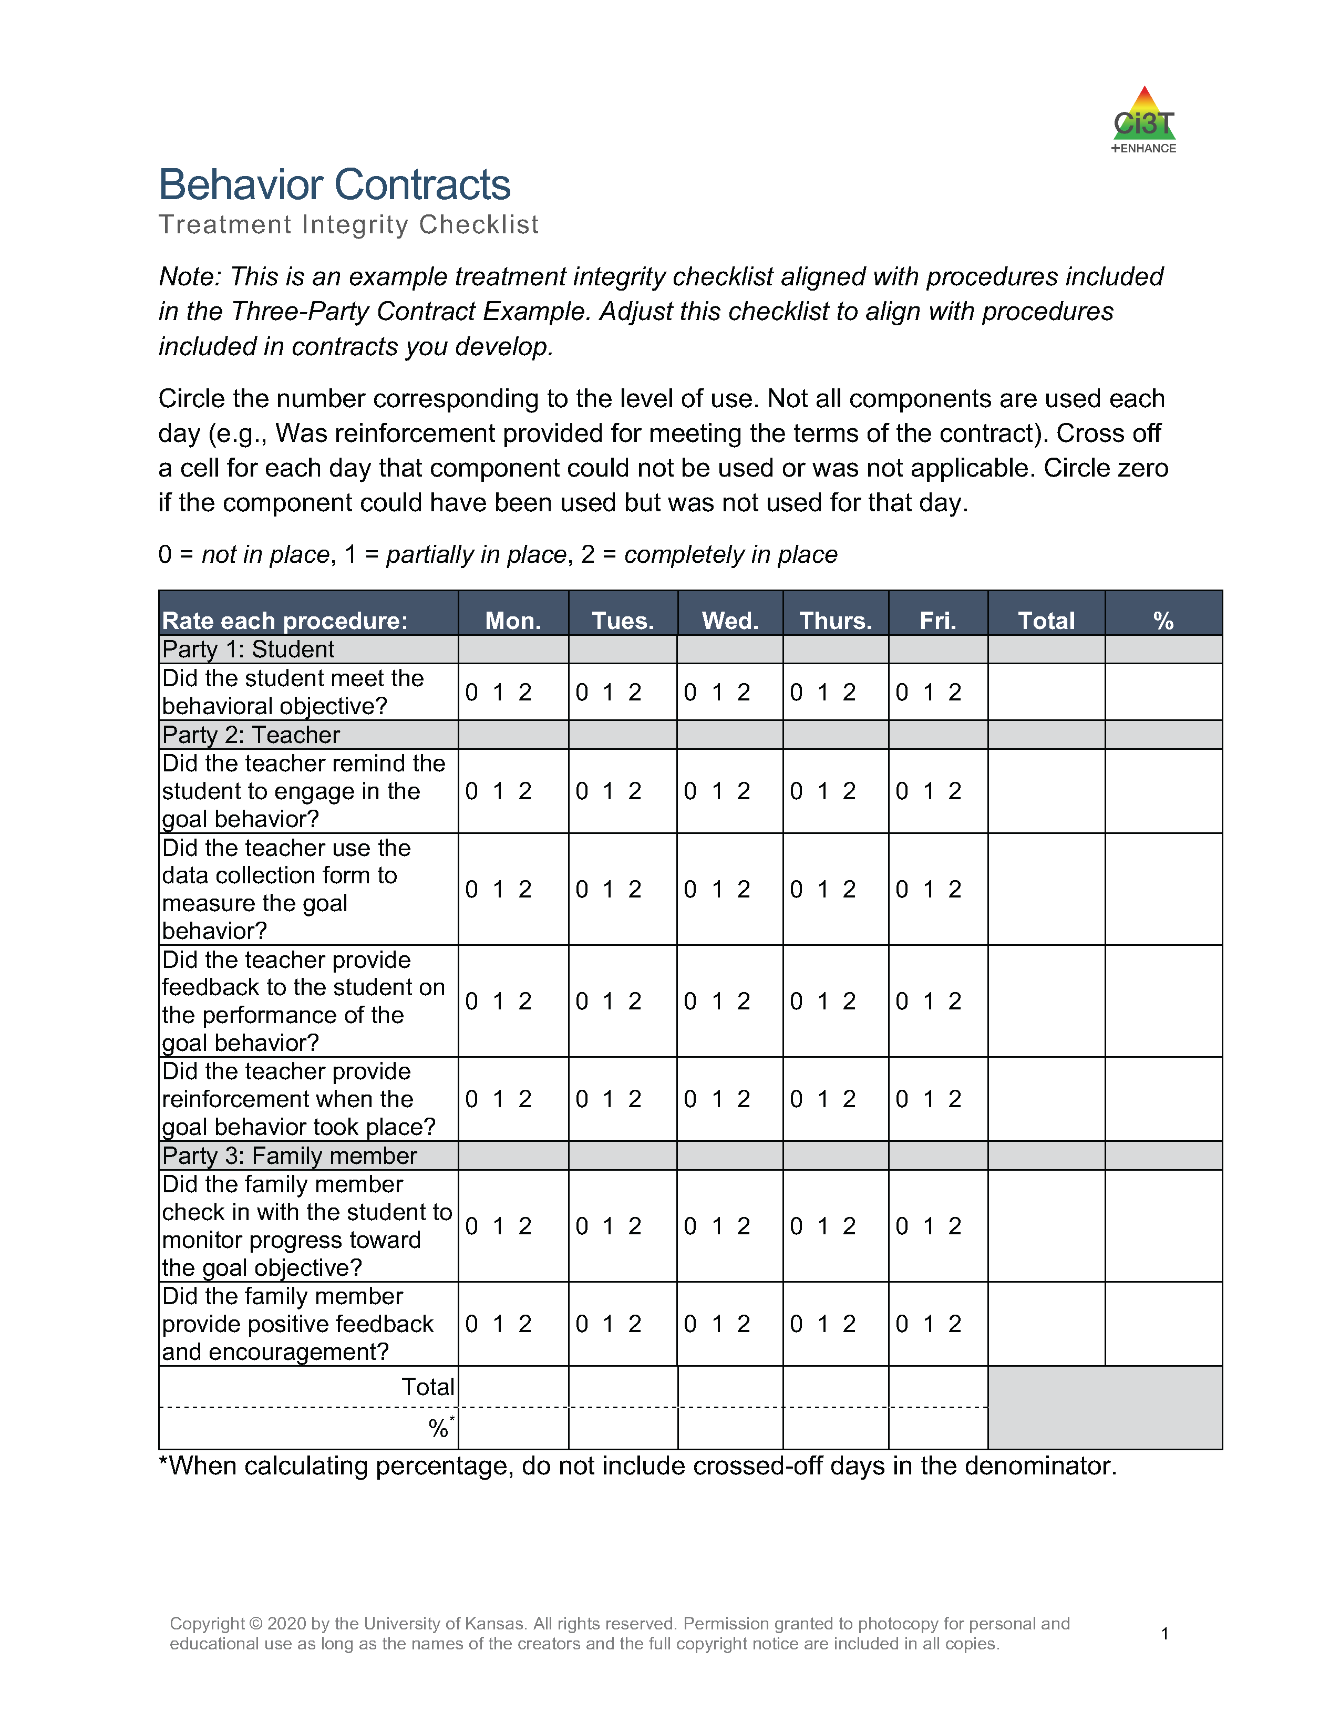
Step 8: Review data weekly
Review treatment integrity data to verify the intervention is being implemented as planned
Monitor progress via weekly review of student performance data weekly
  Check that the goal behavior is moving in the desired direction.
  Make any necessary adjustments to the intervention

Slide 39
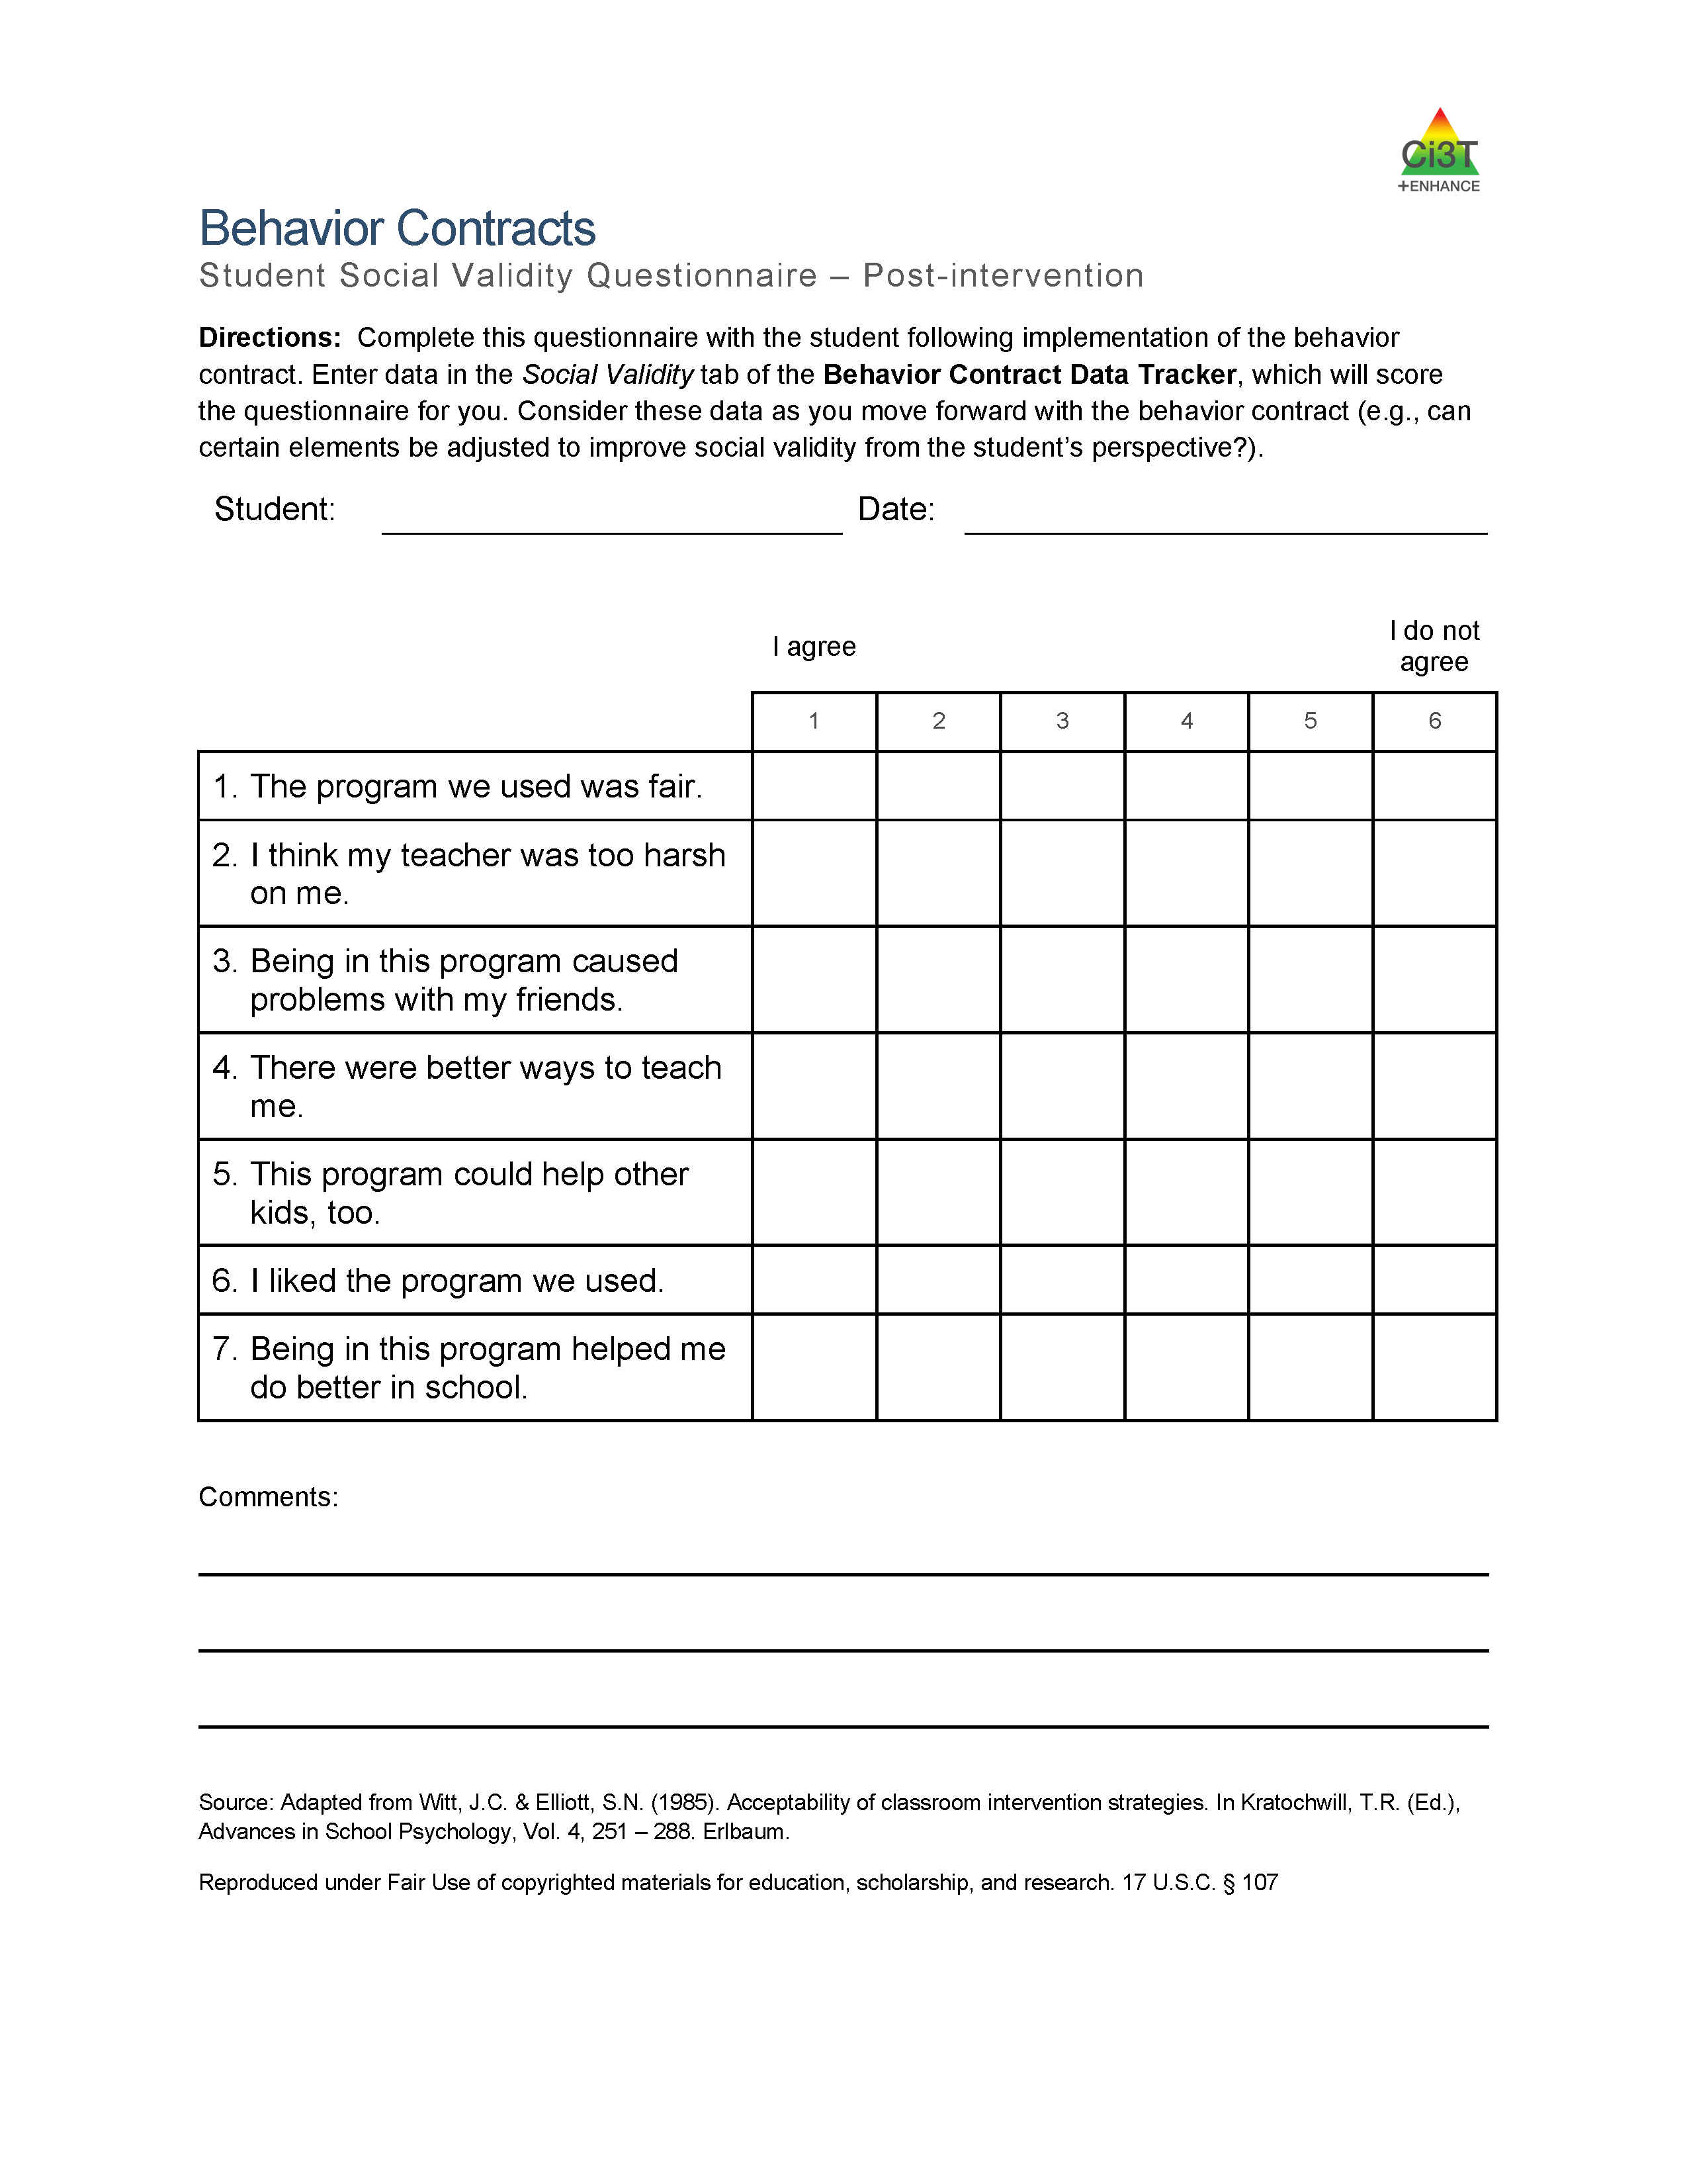
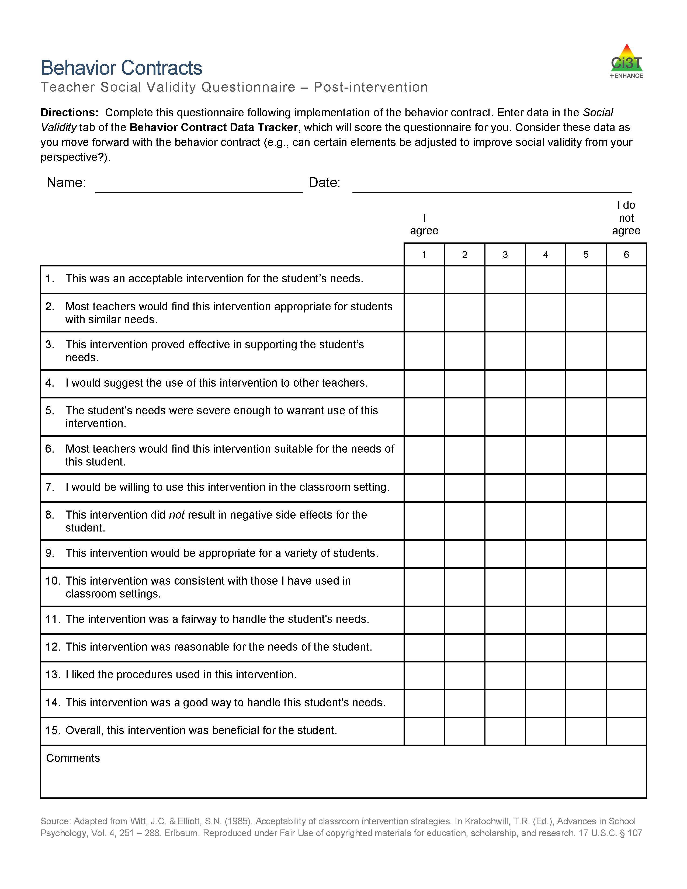
Step 9: Seek input from student and families after 2-3 weeks
Share student performance graph and treatment integrity data
Gather input using student, educator, and family social validity forms

Slide 40
Wrapping Up and Moving Forward

Slide 41
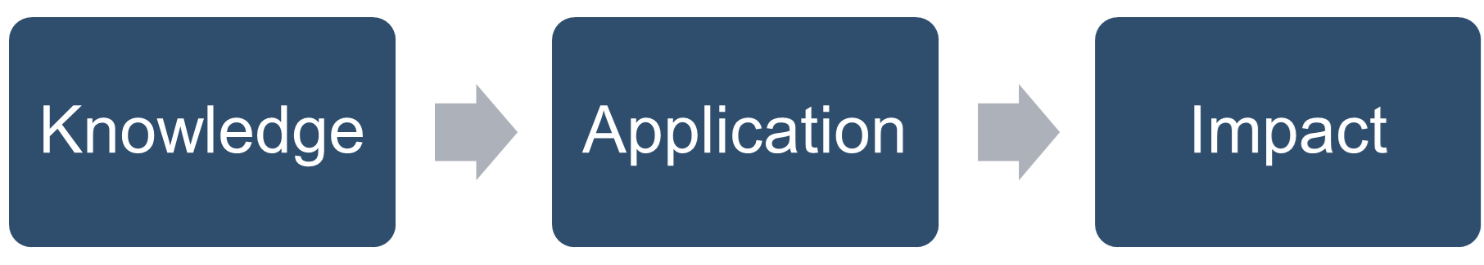

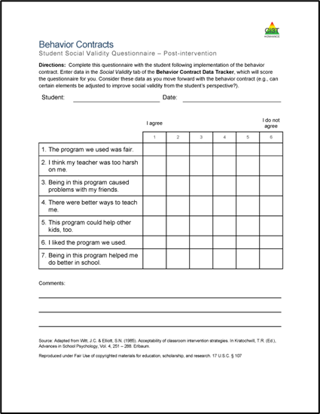
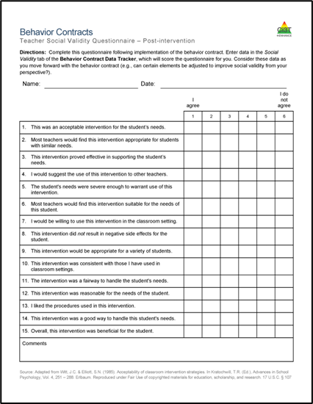
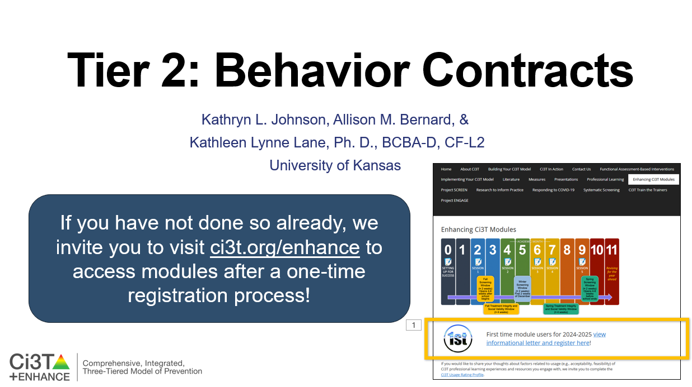
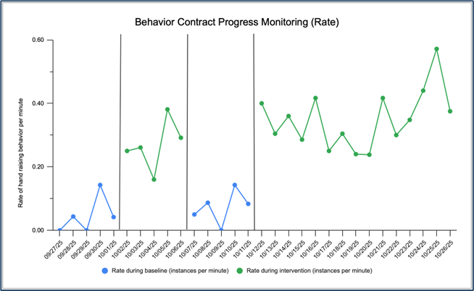
Knowledge, Application, Impact Points
If you are in Kansas, you can earn 2 x PD points for application and 3 x for impact!
We are happy to review your materials before you upload!

Slide 42
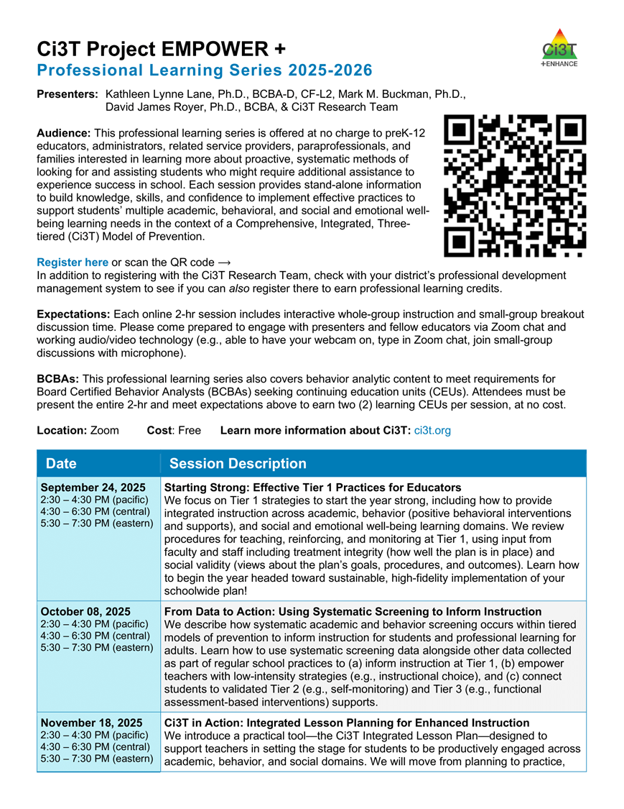
Project EMPOWER+
EMPOWER+ Session | Date
Starting Strong: Effective Tier 1 Practices for Educators | September 24, 2025 (Wednesday)
From Data to Action: Using Systematic Screening to Inform Instruction | October 8, 2025 (Wednesday)
Ci3T In Action: Integrated Lesson Planning for Enhanced Instruction | November 18, 2025 (Tuesday)
Mastering Behavior Specific Praise and Precorrection | January 21, 2026 (Wednesday)
A 6-Step Instructional Approach for Responding to Challenging Behaviors: A Tier 1 Practice | February 10, 2026 (Tuesday)
A Tier 2 Support for Students Experiencing Anxious Feelings: Recognize. Relax. Record. | March 25, 2026 (Wednesday)
A Tier 3 Support for Students with Intensive Intervention Needs: Functional Assessment-Based Intervention (FABI) | April 28, 2026 (Tuesday)

Slide 43

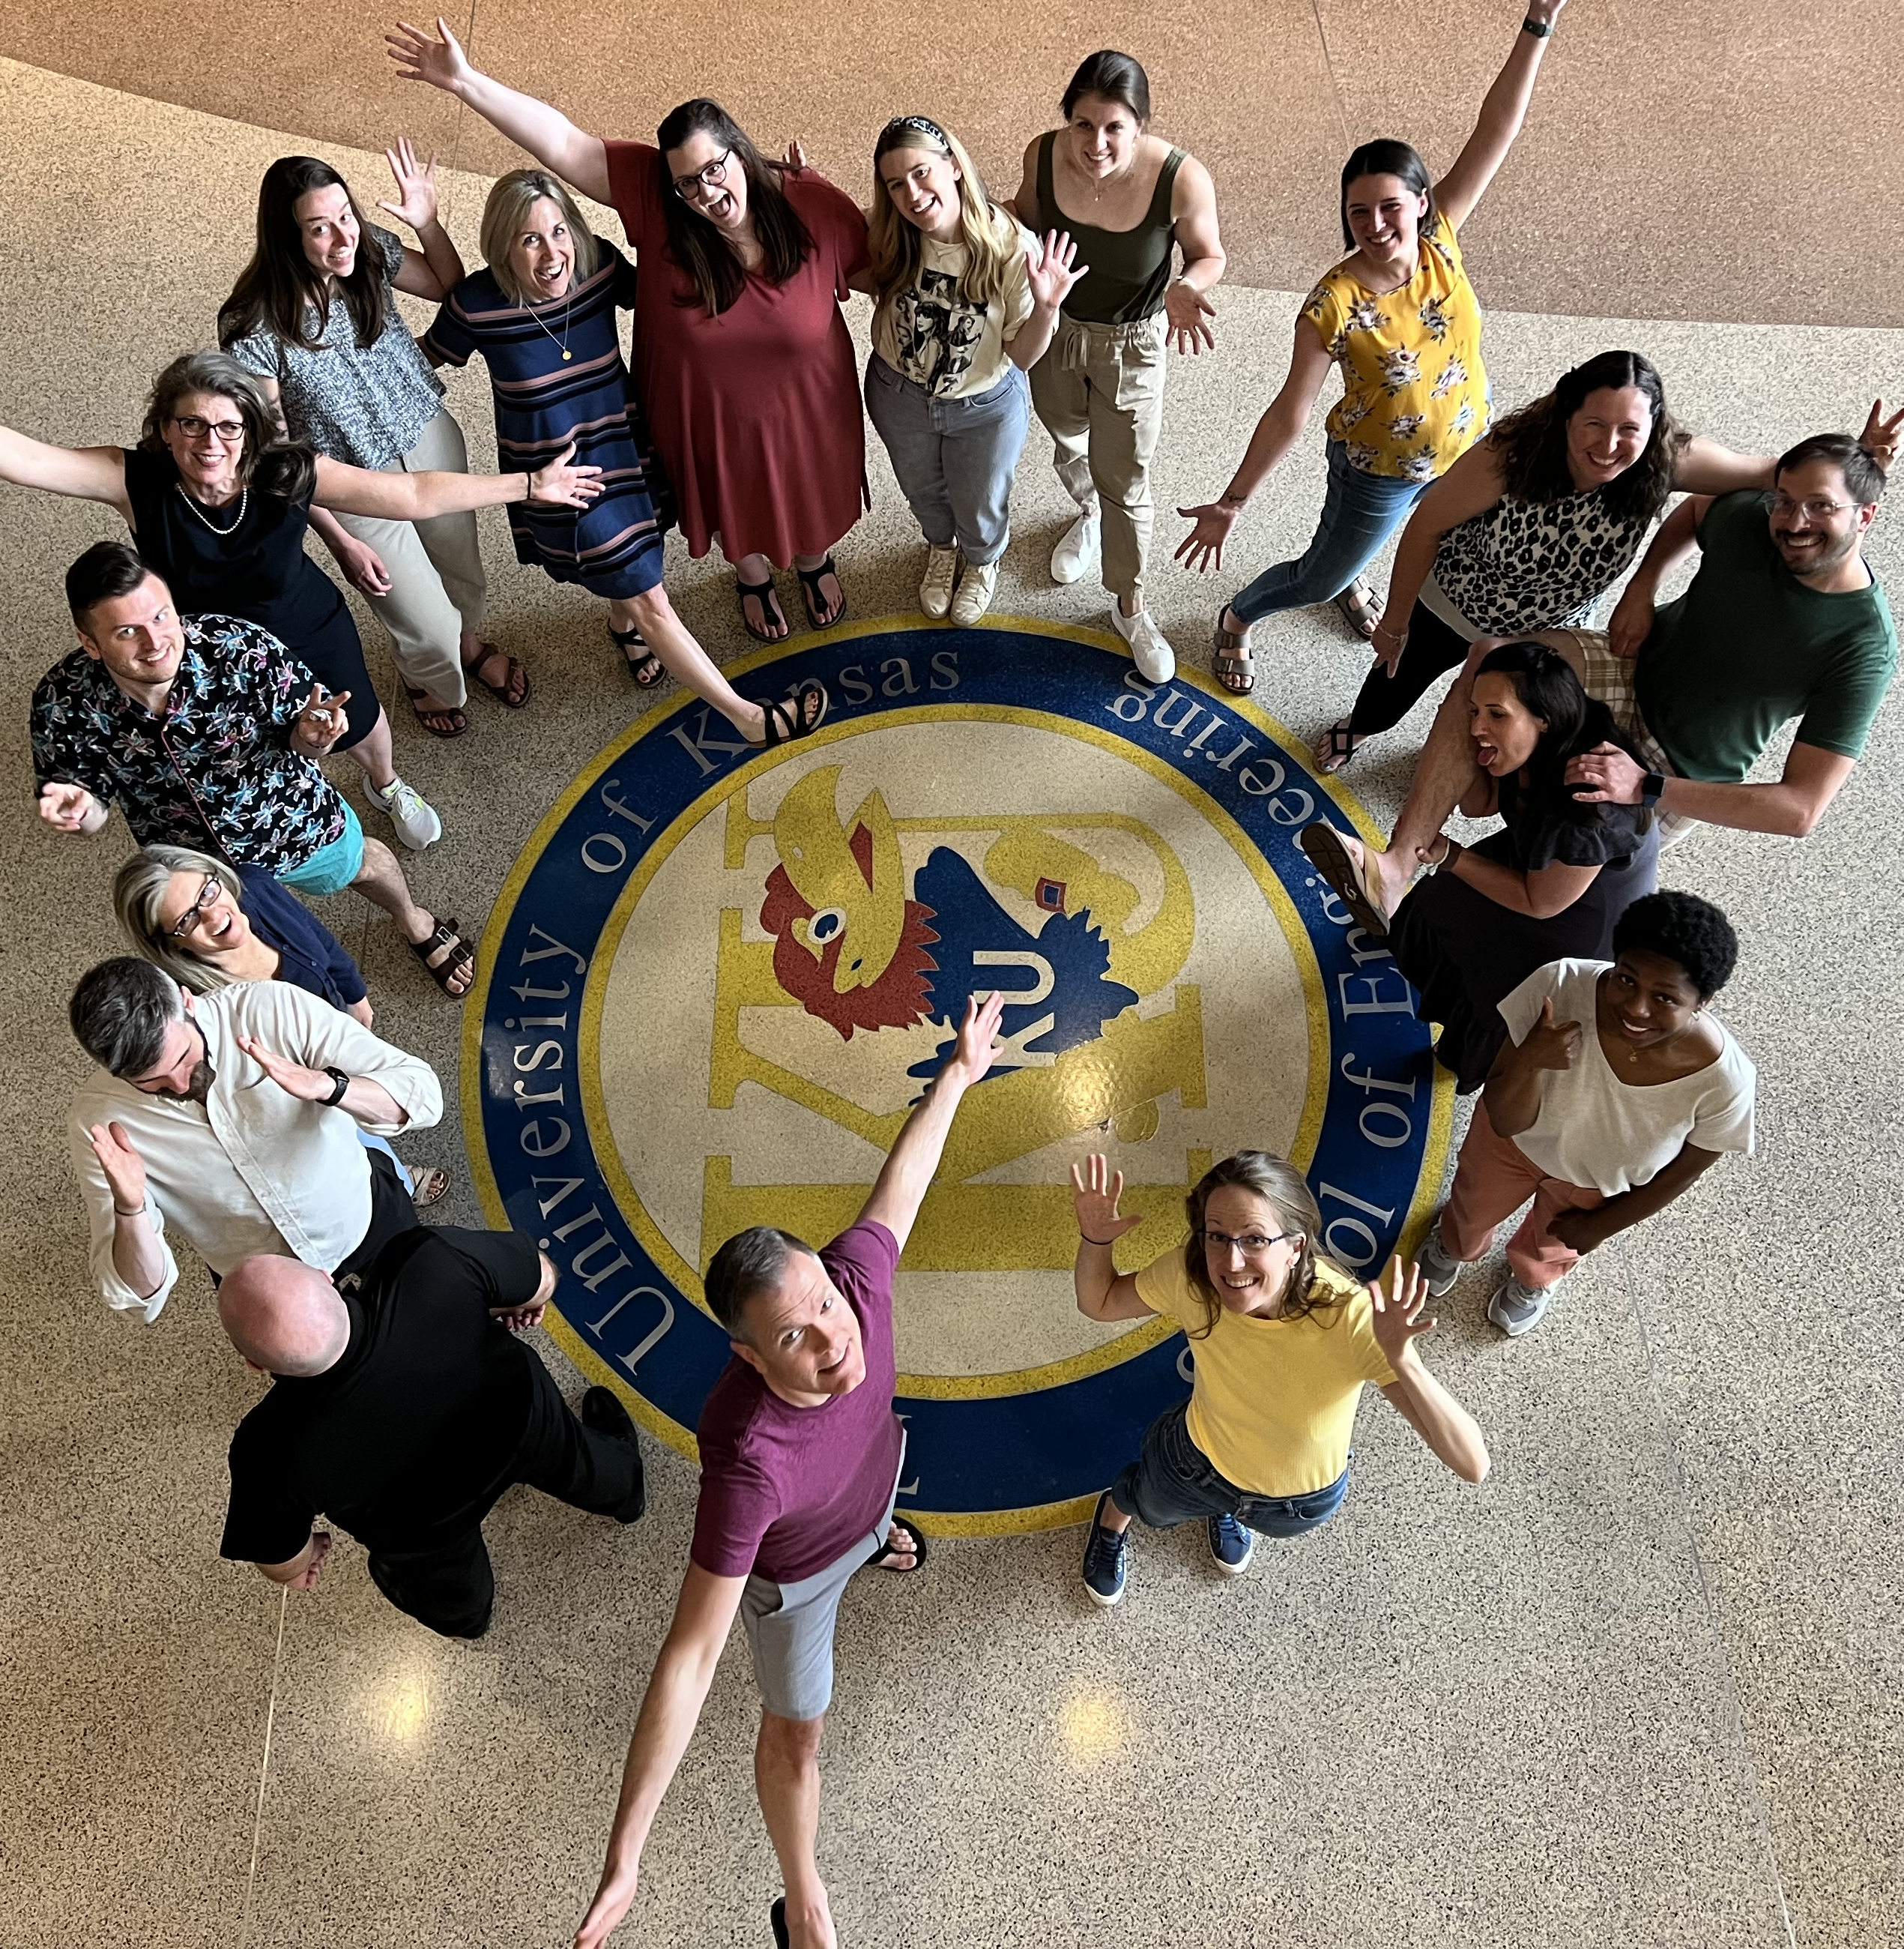

Thank you!
Thank you!
ci3t.org
#Ci3T
@Ci3Tmodel
Tag us in your Ci3T highlights, we love to see Ci3T in action!
Follow us on Instagram for updates and new resources!
Notes:
Tag us in your Ci3T highlights- we would love to see Ci3T in action! Follow us on Instagram for updates and links to resources! @Ci3TModel
You will receive a brief session evaluation – we value your feedback and would greatly appreciate you taking a few minutes to share your thoughts on what you liked about the session and how we can improve

